Slide 1
TSB-funded Technology Inspired CR & D – ICT Project: Trainable Vision-based Anomaly Detection and Diagnosis (TADD)
Quarterly Review Meeting
Ishida Europe Ltd.,
Friday 29th Nov. 2013

Slide 2
Agenda
Summary of progress in Quarter 3 (Aug.-Oct. 2013)
Objectives for the current quarter

Slide 3


Recruitment
Dr Hossein Malekmohamadi, postdoctoral Research Fellow (Nov. 2013 – Oct. 2015)
Dr Ran Song, postdoctoral Research Fellow (July. 2013 – Jun. 2015)

Slide 4
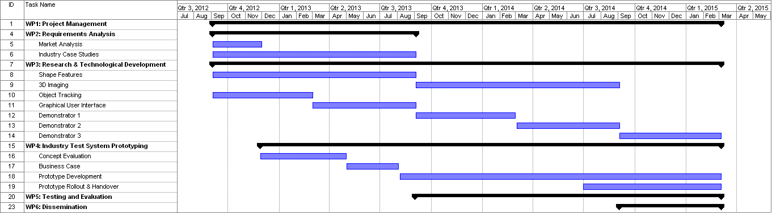
Work Package 3 (from the Project Proposal)

Slide 5
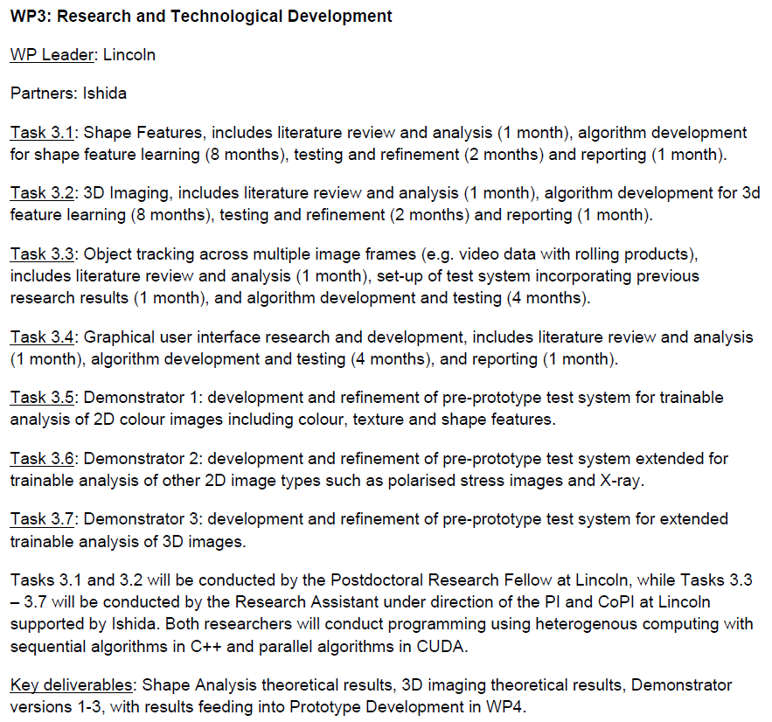
Work Package 3 (from the Project Proposal)

Slide 6
Work Package 3 (from Second Level Project Plan)
Software Phase 1
Key feature | Development feature
Position of tray | What is the orientation of the tray on arrival to the machine.
Tray size | Auto detection of the tray to auto set speeds, timings of sensing and reject.
Detecting top film on a tray. | Printed, clear.
Detecting seal width on a tray. | Measures min/max width. Adjustable by simple +/- setting.
Detecting film position on a tray. | Overhang of film with tolerance. Bowed tray with shrink. Printed film position.
Detecting label on a tray.
Detecting label position on a tray.
Barcode detection
Price detection | Auto character recognition with tick box for fixed or variable data.
Weight detection | Auto character recognition with tick box for fixed or variable data.
Date detection | Auto character recognition with tick box for fixed or variable data.
Detecting other text
Product in seal detection | Adjustable by example setting. Pure visual, laser scattered light and stress pattern analysis.
Product ID for diverger/converger

Slide 7
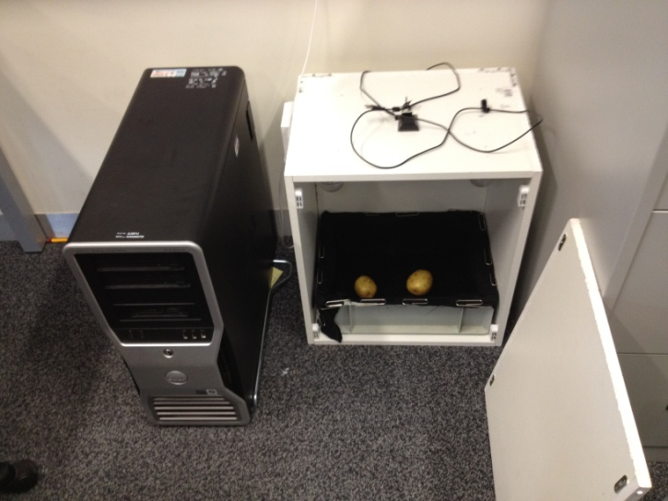
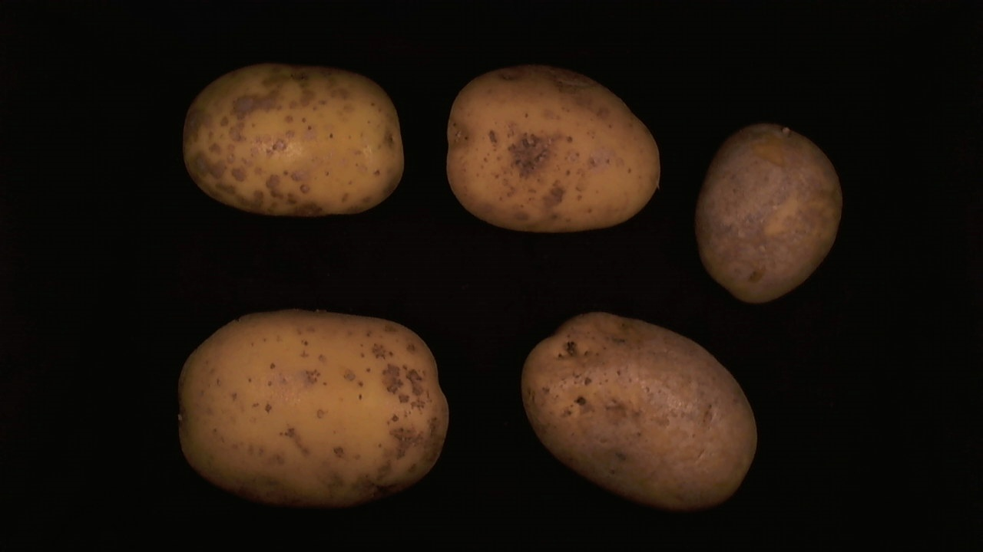
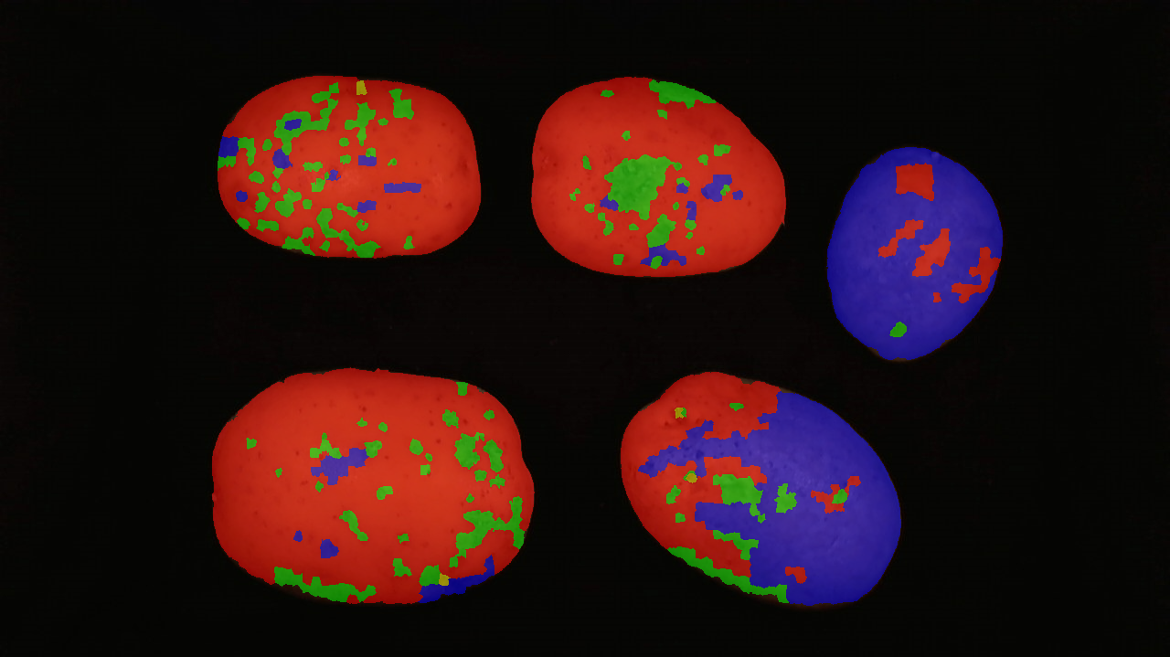
TADD Prototype System
Good Potato
62.7%
Common Scab
11.1%
Silver Scurf
26.0%
Damage
0.2%

Slide 8
Summary of Progress in Quarter 3
Semantic segmentation
Background segmentation using graph-based segmentation
Detection of tray position and size
Barcode detection
Preliminary investigation of local image features (SIFT, SURF) for recognition of image contents

Slide 9
Add detailed slides here

Slide 10
Objectives for Quarter 4
Evaluation and purchase of imaging sensors
3D, colour, laser scatter, etc.
Set up code repository on GitHub
UoL team to visit all sites & gather user requirements
Ishida Europe Ltd., Branston Ltd., AHDB@Sutton Bridge
Packs & Labels Analysis:
Trainable approach to learn label appearance (using local features)
Recovery of label position & orientation (by registration of local features)
How to proceed with the OCR tasks?

Slide 11
Objectives for Quarter 4
Adding 3D information to classification
System currently uses colour and texture features, the best ones are selected by machine learning
Investigate: surface normals and other 3D shape properties
Classification
Currently using AdaBoost (adaptive boosting)
Investigate: random forests, possibly also deep learning

Slide 12
Evaluation of imaging sensors
3D sensors under evaluation
Photo-metric stereo
Structured light (Cognex)
SICK Ranger E: claims 3D, colour and laser scatter imaging all in one sensor!

